Slide 1
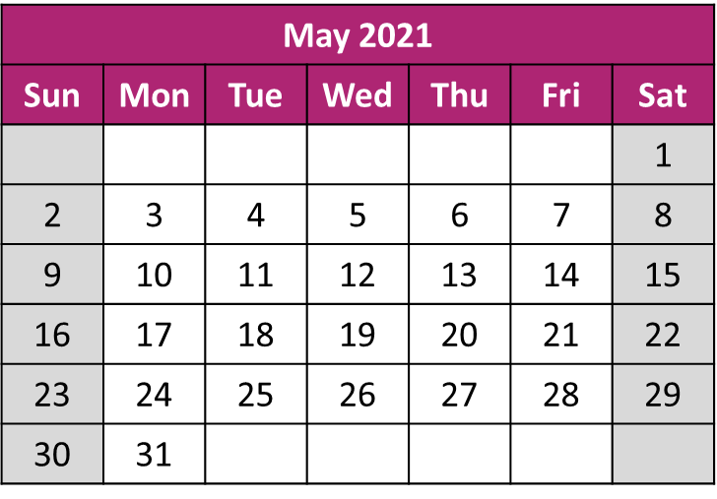
Digital CHC
Share the Learning
“Share the Learning”
Digital CHC
Online Event
Tue 25 May
Online event – an essential for any CHC Team thinking about extending or replacing their CHC software
Exciting Line-up:
Digital CHC Pioneer CCGs/STPs/ICSs
giving an overview of their projects
Digital CHC Case Studies
First view of many of the case studies from the Pioneer sites
“Show and Tell”
Back by popular demand, some of the software houses giving a five-minute glimpse of a recent development
Health Systems Support Framework (HSSF)
Procurement Framework live for CHC
Community Services & Ageing Well
A brief overview of the digital work being looked at across the wider communities programme
Digital CHC Toolkit
Quick overview of the many tools available to help with a Digital CHC project
What is it?
Online Teams meeting to share the learning and benefits realised through the Digital CHC Pioneer projects and the latest developments across the Digital CHC world.
Who for?
Any CCG / ICS / CSU team considering extending or replacing their CHC software or intrigued by the potential benefits of increased digital working in CHC.
When is it?
Tue 25 May 10:00 – 12:00
How to Join
Book your place via the link below and you will be sent joining details nearer to the event
Booking
https://www.events.england.nhs.uk/events/digital-chc---share-the-learning-60940064878b9
Have a question?
Get in touch with tom.oxley1@nhs.net
NHS England and NHS Improvement

